Slide 1

OPUS-College
General description of “Admission” and “Continued Registration” workflows

Slide 2
Introduction
Definition of terms:
Admission (process): the process by means of which is evaluated whether a student is admissible to the university. This process is sometimes also called “Matriculation”.
Continued Registration: the process of (evaluating and) registering a student for a given time unit (semester, trimester, year).
So “Admission” is a one-time process, when a student comes to the university while “Continued Registration” is a repeating process every year, semester or trimester when students have to register for the next phase in their study (that’s why it’s called “continued” registration).

Slide 3
Introduction
Both the Admission and the Continued Registration process include a certain number of evaluation or control steps which together constitute the Workflow of the process.
These workflows or steps are also implemented in OPUS-College: the system allows to control whether a student meets the requirements of a given step in the process (e.g. whether he has paid the fees) and – if yes – to transfer the student to the next step in the process.

Slide 4
Steps in the Admission Workflow
The Admission workflow in OPUS-College contains the following steps in the order given:
Waiting for payment: after the student has filled in the (online) admission form in OPUS-College, he gets the status “Waiting for payment”.
Waiting for selection: as soon as the student has paid the admission fee, he will be transferred to the “Waiting for selection” status. Once in this status it will be controlled whether the student meets the requirements set by the School in question for the secondary school subjects.
Approved admission or Rejected admission: if the student meets the secondary school selection criteria, he/she is transferred to the status “Approved admission” otherwise he/she will be “Rejected”.
All (evaluation) steps in the Admission Workflow in OPUS
are performed by the Academic Office.

Slide 5
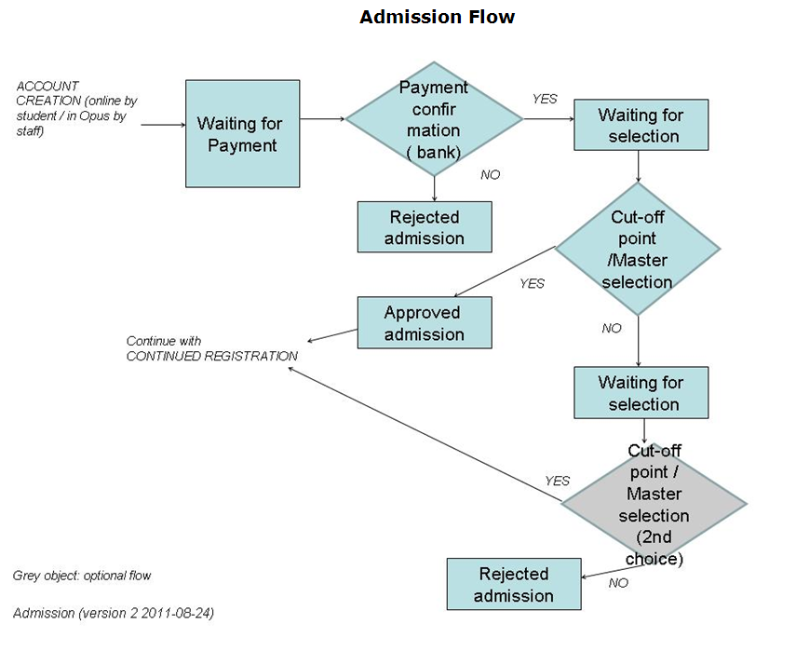
Schematic

Slide 6
Steps in the Continued Registration Workflow
The Continued Registration workflow in OPUS-College contains the following steps in the order given:
Waiting for payment: as long as the student has not paid the fees for the next time unit (year, semester, trimester).
Waiting for selection: as soon as the student has paid the admission fee, he/she will be transferred to the “Waiting for selection” status. In this status it will be controlled whether the student really meets the requirements to pass to the next time unit (year, semester, trimester).
Customize program: if the student meets the previous step, he/she is transferred to the status “Customize program”, which allows the Head of the Department or the student itself to make adjustments to the study program for the given time unit (e.g. to add elective courses or to remove a course already taken previously. If no adjustments are necessary, this step is “empty”.
Waiting for approval: after passing the previous steps, the Dean still has formally to approve the registration for the next time unit.
Actively registered: after approval by the Dean, the student then is officially registered for the new semester (or year or trimester, whatever time unit used).
The (evaluation) steps in the Continued Registration workflow
are performed by the Dean of the School, except “Customize
Program” which is performed by the Head of Dept. or the student.

Slide 7
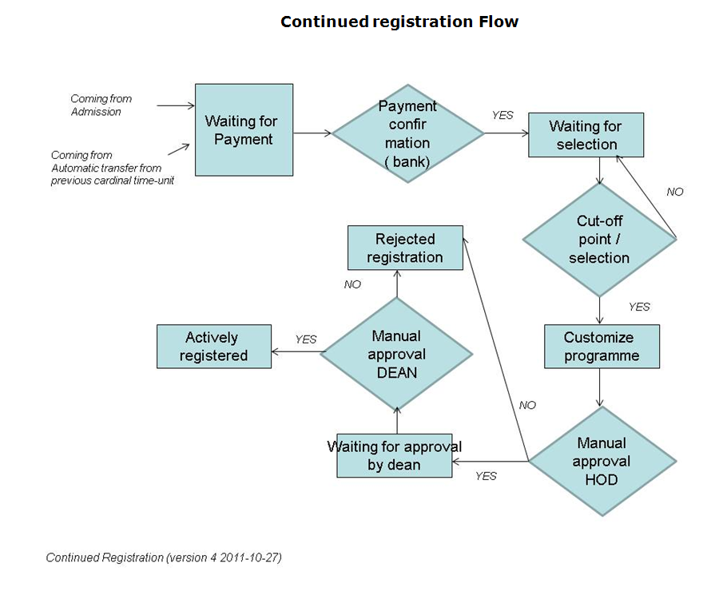
Schematic

